Slide 1


Real-Time Rendering
Carl Jones
DirectX 11 Rendering

Slide 2
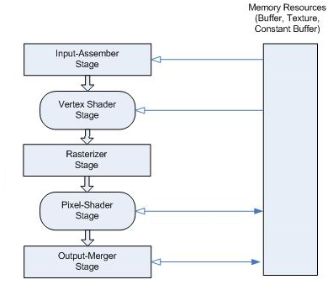
Graphics pipeline stages to setup
Simplified view of key Pipeline stages

Slide 3
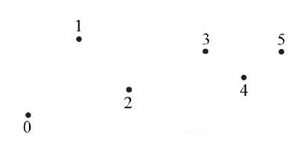
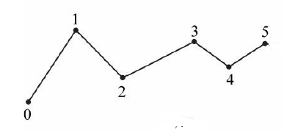
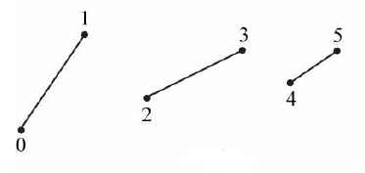
Input Assembler Stage
D3D11_PRIMITIVE_TOPOLOGY_POINTLIST
Vertices are drawn as points
D3D11_PRIMITIVE_TOPOLOGY_LINESTRIP
n + 1 are required to draw n lines
D3D11_PRIMITIVE_TOPOLOGY_LINELIST
2n required to draw n lines – lines need not be connected
e.g. Use method: IASetPrimitiveTopology(
D3D11_PRIMITIVE_TOPOLOGY_LINELIST);

Slide 4
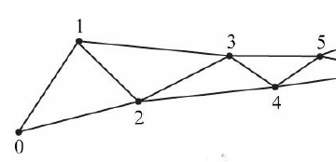
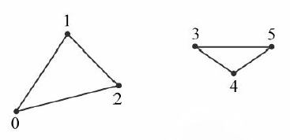
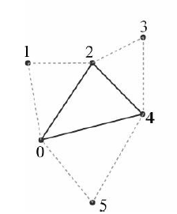
Input Assembler Stage
D3D11_PRIMITIVE_TOPOLOGY_TRIANGLESTRIP. By assuming connectivity, we see that vertices are shared between adjacent triangles, and n vertices induce n – 2 triangles.
D3D11_PRIMITIVE_TOPOLOGY_TRIANGLELIST
3n vertices induces n triangles.
D3D11_PRIMITIVE_TOPOLOGY_LINELIST
2n required to draw n lines – lines need not be connected
e.g. Use method: IASetPrimitiveTopology(
D3D11_PRIMITIVE_TOPOLOGY_LINELIST);

Slide 5
Primitives with Adjacency
D3D11_PRIMITIVE_TOPOLOGY_TRIANGLELIST_ADJ
for each triangle, you also include three neighbouring adjacent triangles
Used for the geometry shader, they are not drawn
Notes:
where certain geometry shading
algorithms need access to the adjacent triangles. In order for the geometry shader to get those adjacent triangles, the adjacent triangles
need to be submitted to the pipeline in the vertex/index buffers along with the triangle itself, and the

Slide 6
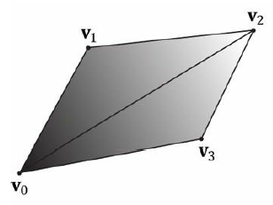
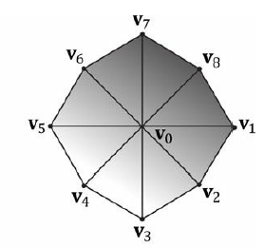
Indices
Vertex quad[6] = {
v0, v1, v2, // Triangle 0
v0, v2, v3, // Triangle 1
};
Vertex octagon[24] = {
v0, v1, v2, // Triangle 0
v0, v2, v3, // Triangle 1
v0, v3, v4, // Triangle 2
v0, v4, v5, // Triangle 3
Etc…

Slide 7
Graphics pipeline stages to setup
Simplified view of key Pipeline stages

Slide 8
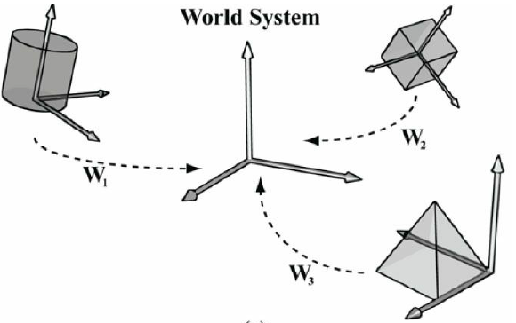
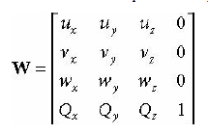
The Vertex Shader Stage
The Vertex shader processes each vertex .
Commonly the vertex shader will transform each vertex from local space to world space.
W=SRT
Model or World Transform

Slide 9
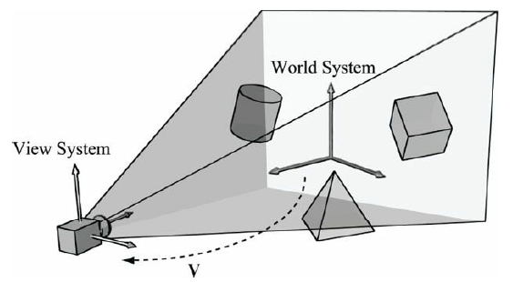
View/Camera Space (vertex shader)
Secondly the vertex shader commonly transforms vertices to from World Space to View Space
// Outputs resulting view matrix V
XMMATRIX XMMatrixLookAtLH(
FXMVECTOR EyePosition, // Input camera position Q
FXMVECTOR FocusPosition, // Input target point T
FXMVECTOR UpDirection); // Input world up vector j

Slide 10
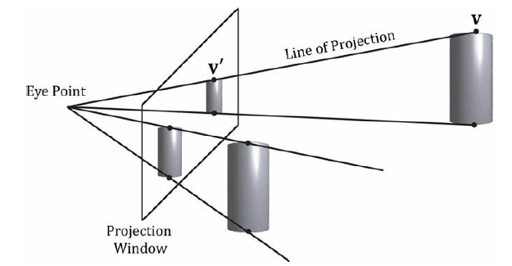
Projection and Homogeneous Clip Space
// returns projection matrix
XMMATRIX XMMatrixPerspectiveFovLH(
FLOAT FovAngleY, // vertical field of view angle in radians
FLOAT AspectRatio, // aspect ratio = width / height
FLOAT NearZ, // distance to near plane
FLOAT FarZ ); // distance to far plane

Slide 11
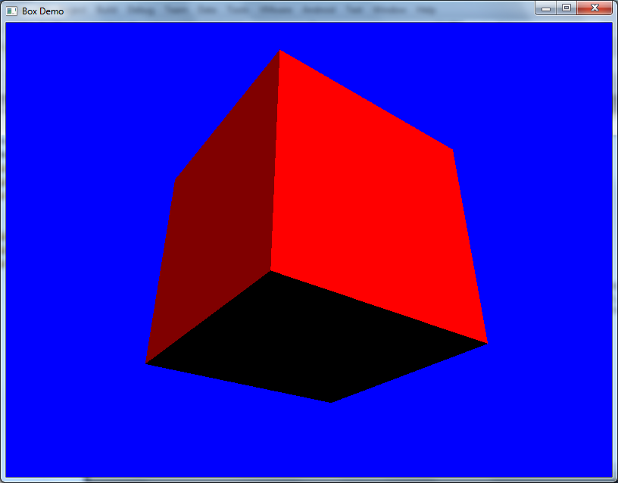
Basic Diffuse Light Shader

Slide 12
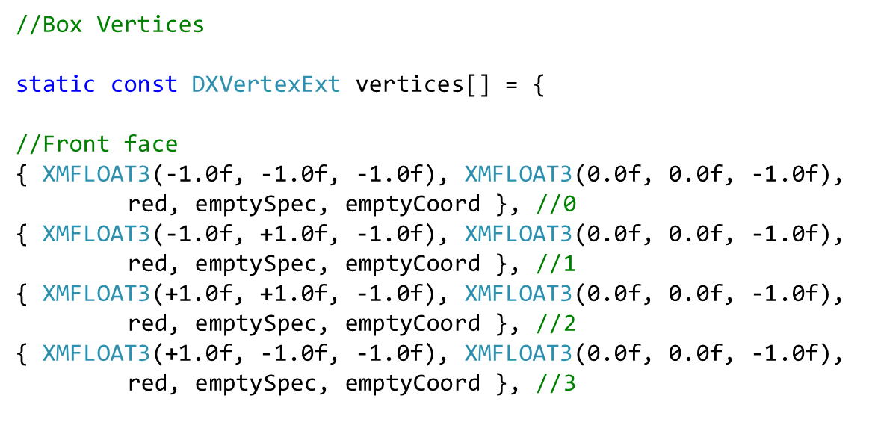
Vertex Duplication

Slide 13
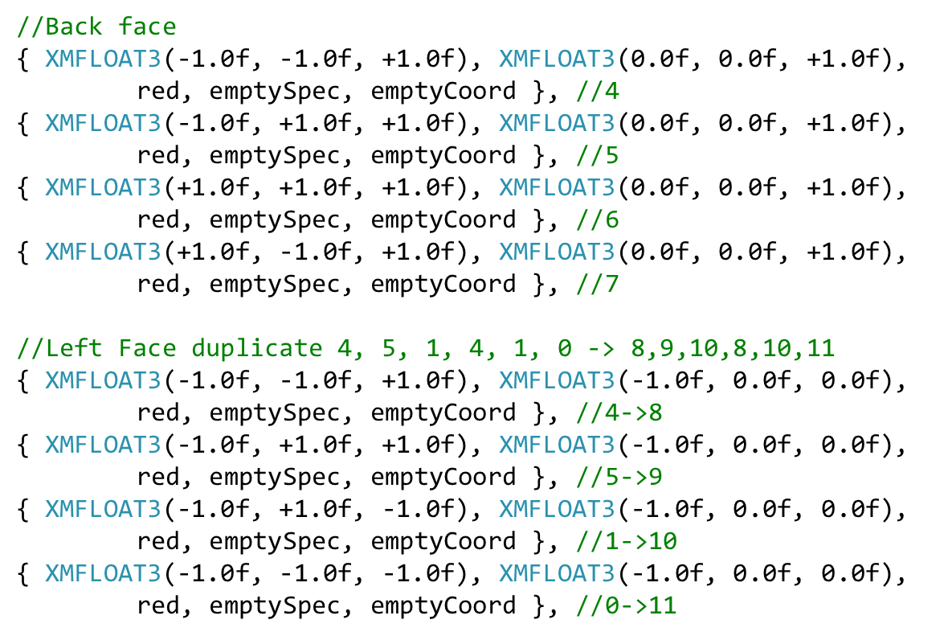

Slide 14
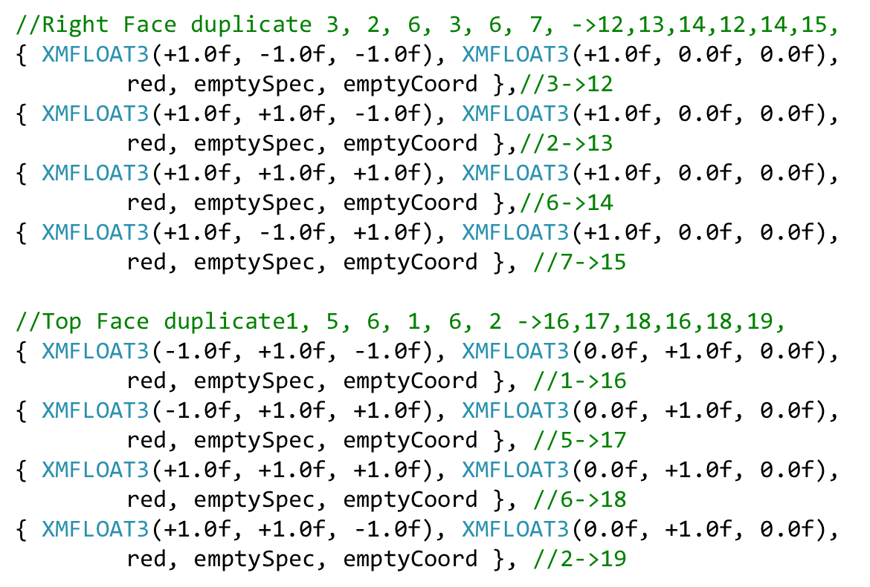

Slide 15
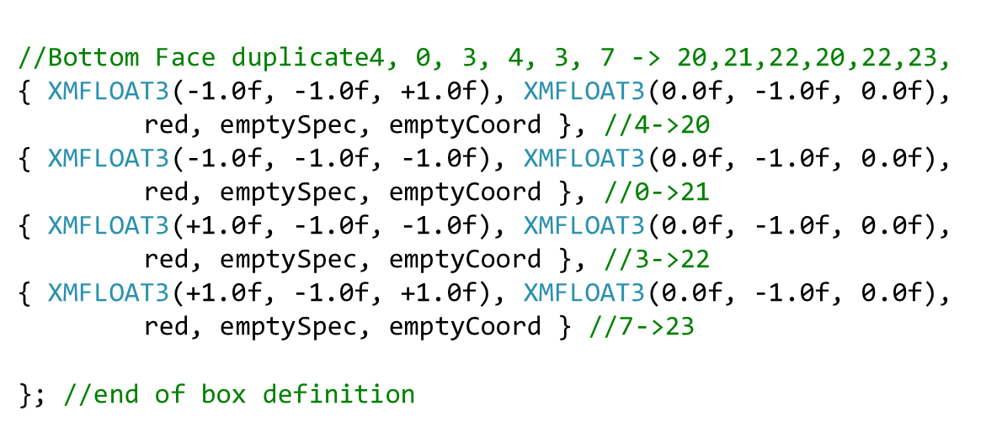

Slide 16
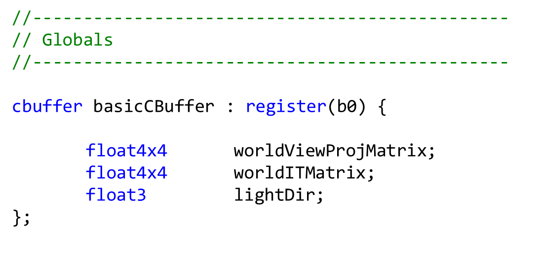
Cbuffer – declaration in vertex shader

Slide 17
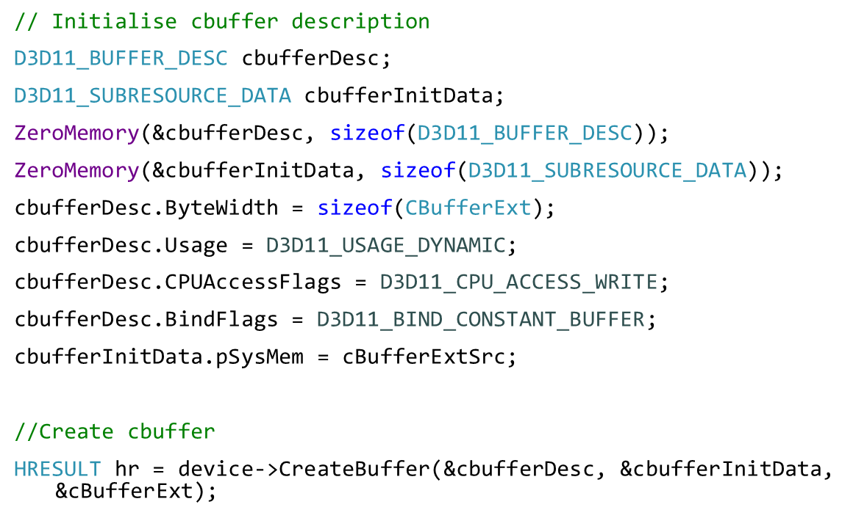
Create CBuffer

Slide 18
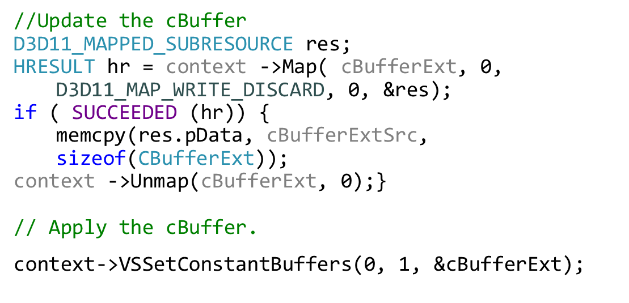
Update Cbuffer – before rendering

Slide 19
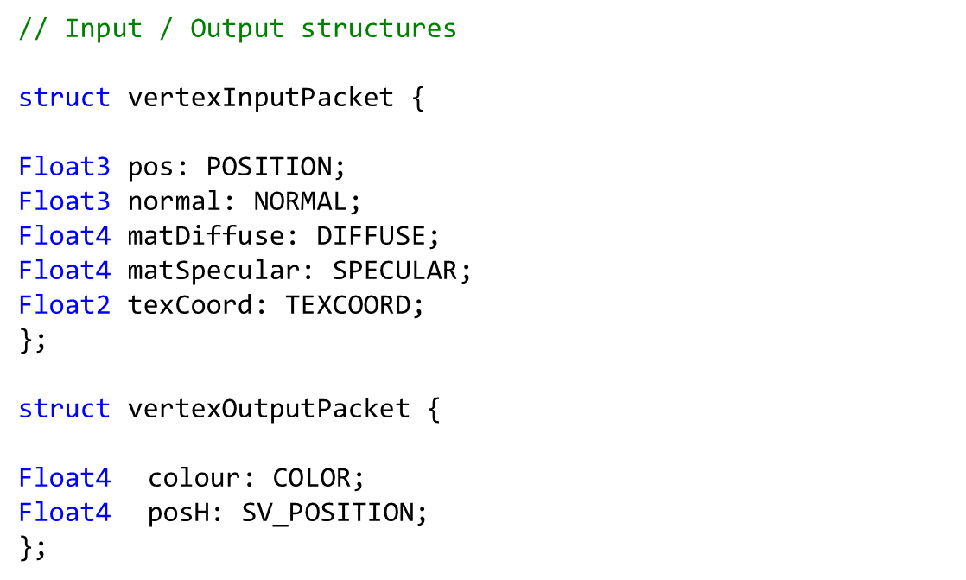
Extended Vertex Shader - Input /Output Structures
Semantics

Slide 20
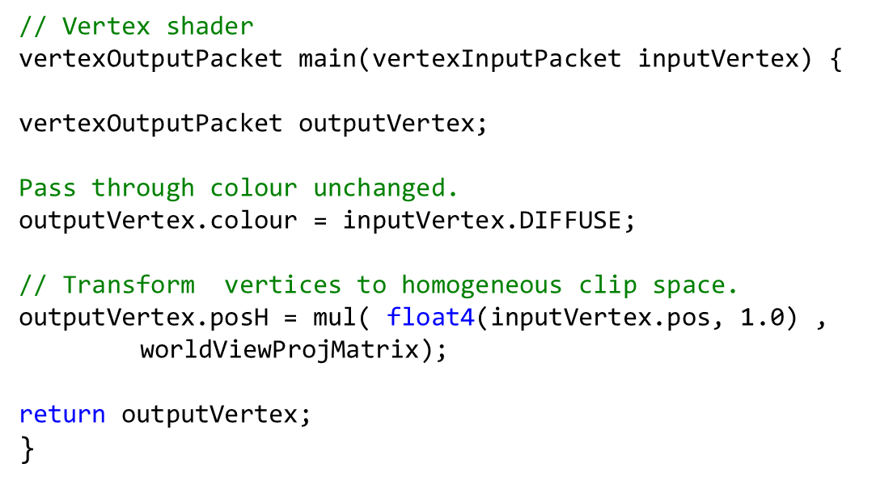
Simple Vertex Shader

Slide 21
Simple Diffuse lighting
Intensity is proportional to cos(a)
If the light and normal vectors are normalized
N.L = cos(a)
Colour = DiffuseColour * saturate ( dot( L , N ) );
N
L
a
Diffuse

Slide 22
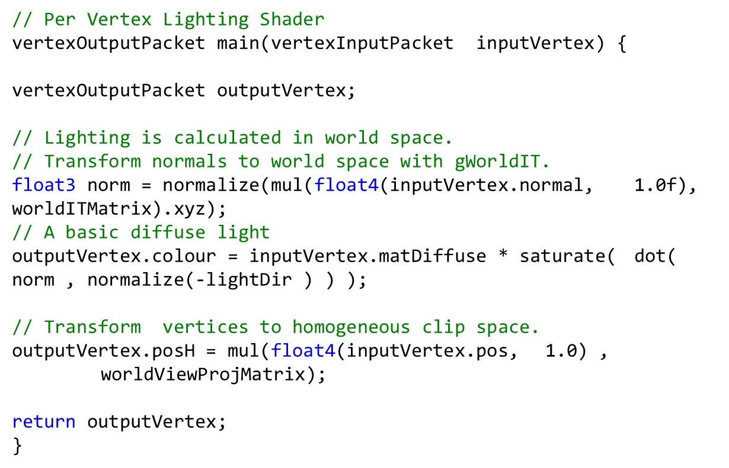
Simple Lighting Vertex Shader

Slide 23
Basic Diffuse Light Shader

